Slide 1

Automotive Technology: A Systems Approach, 8e
Chapter 22: Basics of Electronics and Computer Systems
Rob Thompson and Jack Erjavec, Automotive Technology: A Systems Approach, 8th Edition. © 2025 Cengage. All Rights Reserved. May not be scanned, copied or duplicated, or posted to a publicly accessible website, in whole or in part.

Slide 2
Chapter Objectives (1 of 2)
22.01 Describe the functions and uses of capacitors.
22.02 Explain what semiconductors are and their uses in automotive electronics.
22.03 List and describe the functions of the various sensors used by computers.
22.04 Explain the advantages of using electronic control systems.
22.05 Explain the principle of multiplexing.

Slide 3
Chapter Objectives (2 of 2)
22.06 Explain the principle of computer communications.
22.07 List and describe the operation of output actuators.
22.08 Describe the precautions that must be taken when diagnosing modules and networks.
22.09 Reprogram a control module in a vehicle.
22.10 Perform a communications check on a multiplexed system.

Slide 4
Capacitors (1 of 3)
22.01 Describe the functions and uses of capacitors.
A capacitor is used to store and release electrical energy.
Capacitors can be used to smooth out current fluctuations, store and release a high voltage, or block DC voltage.
Capacitors are sometimes called condensers.
Although a battery and a capacitor store electrical energy, the battery stores the energy chemically.
A capacitor stores energy in an electrostatic field created between a pair of electrodes.
A capacitor can release all of its charged energy in an instant, whereas a battery slowly releases its charge.
A capacitor is quick to discharge and quick to charge.

Slide 5
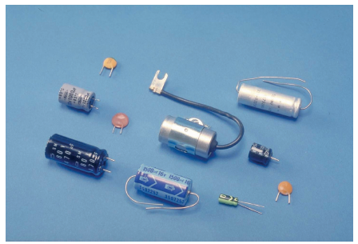
Capacitors (2 of 3)
A capacitor has a positive and a negative terminal.
Each terminal is connected to a thin electrode or plate (usually made of metal).
The plates are parallel to each other and are separated by an insulating material called a dielectric.
The dielectric can be paper, plastic, glass, or anything that does not conduct electricity.
Placing a dielectric between the plates allows the plates to be placed close to each other without allowing them to touch.
When voltage is applied to a capacitor, the two electrodes receive equal but opposite charges.
The negative plate accepts electrons and stores them on its surface.
The other plate loses electrons to the power source.

Slide 6
Capacitors (3 of 3)
A capacitor’s capacitance is directly proportional to the surface areas of the plates and the nonconductiveness of the dielectric and is inversely proportional to the distance between the plates.
Most capacitors have a capacitance rating of much less than a farad, and their values are expressed in one of these terms:
  Microfarads: μF (1 μF = 10–6 F)
  Nanofarads: nF (1 nF = 10–9 F)
  Picofarads: pF (1 pF = 10–12 F)
Capacitors oppose a change of voltage.
If a battery is connected to a capacitor, the capacitor will be charged when current flows from the battery to the plates.
This current flow will continue until the plates have the same voltage as the battery.
At this time, the current flow stops and the capacitor is charged and will remain charged until the circuit voltage drops low, and the capacity will begin to discharge.
In this way, the capacitor stabilizes the voltage level.

Slide 7
Semiconductors (1 of 2)
22.02 Explain what semiconductors are and their uses in automotive electronics.
A semiconductor is a material or device that can serve as a conductor or an insulator.
Semiconductors have no moving parts; therefore, they seldom wear out or need adjustment.
Semiconductors, or solid-state devices, are also small, require little power to operate, are reliable, and generate very little heat.
For all these reasons, semiconductors are being used in many applications.
However, current to them must be limited, as should heat.
Because a semiconductor can function as both a conductor and an insulator, it is often used as a switching device.
How it behaves depends on what it is made of and which way current flows (or tries to flow) through it.
Semiconductor materials have less resistance than an insulator but more resistance than a conductor and also have a crystal structure.

Slide 8
Semiconductors (2 of 2)
Two common semiconductor devices are diodes and transistors.
Diodes are used for isolation of circuits, clamping, or rectification of AC to DC.
Transistors are used for amplification or switching.
The type of impurity determines the type of semiconductor.
N-type semiconductors have loose, or excess, electrons.
  They have a negative charge and can carry current. N-type semiconductors have an impurity with five electrons in the outer ring (called pentavalent atoms). Four of these electrons fit into the crystal structure, but the fifth is free. This excess of electrons produces the negative charge.
P-type semiconductors are positively charged materials.
  They are made by adding an impurity with three electrons in the outer ring (trivalent atoms). When this element is added to silicon or germanium, the three outer electrons fit into the pattern of the crystal, leaving a hole where a fourth electron would fit. This hole is actually a positively charged empty space. This hole carries the current in the P-type semiconductor.

Slide 9
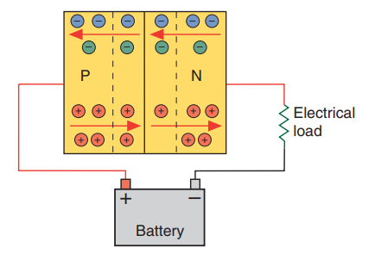
Diodes (1 of 2)
The most commonly used are regular diodes, LEDs, Zener diodes, clamping diodes, and photo diodes.
A diode allows current to flow in one direction; therefore, it can serve as a conductor or insulator, depending on the direction of current flow.
In a generator, voltage is rectified by diodes. Diodes are arranged so that current can leave the AC generator in one direction only (as direct current).
Inside a diode are positive and negative areas that are separated by a boundary area called the PN junction.
When the positive side of a diode is connected to the positive side of the circuit, it is said to have forward bias.

Slide 10
Diodes (2 of 2)
A Zener diode works like a standard diode until a certain voltage is reached.
When the voltage reaches this point, the diode allows current to flow in the reverse direction.
Zener diodes are often used in electronic voltage regulators.
LEDs emit light as current passes through them.
The color of the emitted light depends on the material used to make the LED.
Typically, LEDs are made of a variety of inorganic semiconductor materials that produce different colors.
Whenever the current flows through a coil of wire, such as used in a solenoid or relay stops, a voltage surge or spike is produced.
The movement of the field across the winding induces a very high-voltage spike, which can damage electronic components.
In the past, a capacitor was used as a “shock absorber” to prevent component damage from this surge.
On today’s vehicles, a clamping diode is commonly used to prevent this voltage spike.

Slide 11
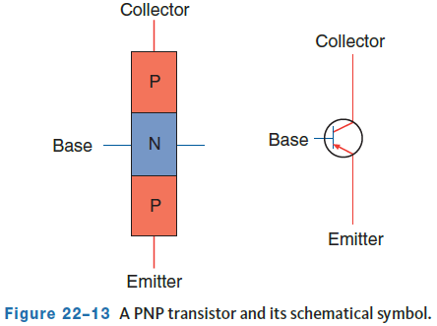
Transistors (1 of 3)
A transistor is produced by joining three sections of semiconductor materials.
Like the diode, it is used as a switching device, functioning as either a conductor or an insulator.
A transistor resembles a diode with an extra side.
It can consist of two P-type materials and one N-type material or two N-type materials and one P-type material.
These are called PNP and NPN types. In both types, junctions occur where the materials are joined.
Notice that each of the three sections has a lead connected to it, and this allows any of the three sections to be connected to the circuit.
The names for the legs are the emitter, base, and collector.

Slide 12
Transistors (2 of 3)
The center section is called the base and is the controlling part of the circuit or where the larger controlled part of the circuit is switched.
The path to ground is through the emitter.
A resistor is normally in the base circuit to keep current flow low which prevents damage to the transistor.
The emitter and collector make up the control circuit.
When a transistor is drawn in an electrical schematic, the arrow on the emitter points in the direction of current flow.
The base of a PNP transistor is controlled by its ground.
Current flows from the emitter through the base, then to ground.
A negative voltage or ground must be applied to the base to turn on a PNP transistor. When the transistor is on, the circuit from the emitter to the collector is complete.
An NPN transistor is the opposite of a PNP.
When positive voltage is applied to the base of an NPN transistor, the collector-to-emitter circuit is turned on.

Slide 13
Transistors (3 of 3)
Transistors can also function as a variable switch.
By varying the voltage applied to the base, the completeness of the emitter and collector circuit will also vary.
This is done simply by the presence of a variable resistor in the base circuit.
This principle is used in light-dimming circuits.
Insulated gate bipolar transistors (IGBTs) are a variation of standard transistors that include a metal oxide semiconductor field effect transistor (MOSFET) in the base circuit.
IGBTs are very fast and efficient switches that are used in the inverter power circuits in hybrid and electric drive systems.
The rapid and precise switching of direct current from the high-voltage battery by the inverter is transformed into alternating current for the drive motors.

Slide 14
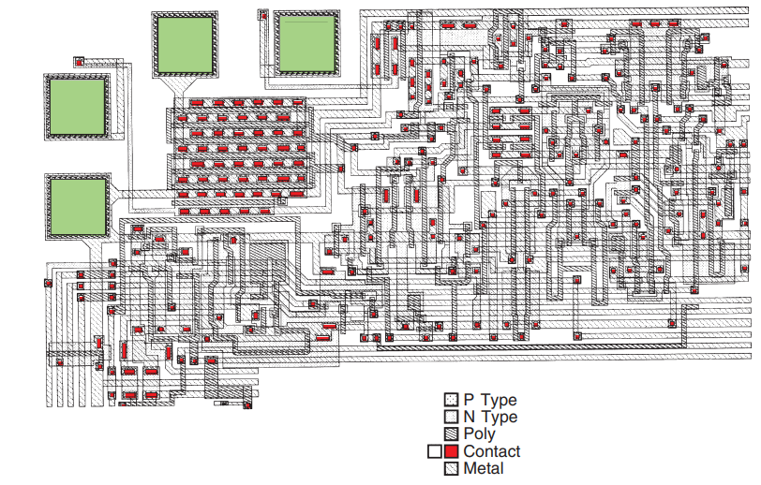
Integrated Circuits
When many semiconductors are combined in a circuit, they can perform complex functions.
An integrated circuit is simply a large number of diodes, transistors, and other electronic components mounted on a single piece of semiconductor material.
This creates a very small package capable of performing many functions.
Because of the size of an integrated circuit, many transistors, diodes, and other solid-state components can be installed in a car to make logic decisions and issue commands.

Slide 15
Discussion
You have learned about semiconductors including diodes, transistors, and integrated circuits.
Have a class discussion while providing several examples of how these technologies have replaced more traditional switches and relay-based electronics and what the advantages are of the newer solid state electronics.

Slide 16
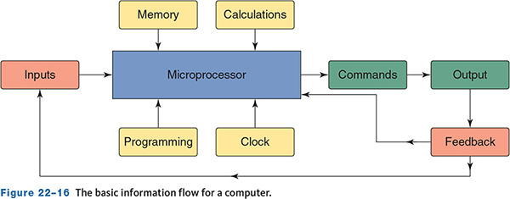
Computer Basics (1 of 2)
Computers control nearly all of the systems in an automobile.
Systems that once were controlled by vacuum, mechanical, and electromechanical devices are now controlled and operated by electronics.
These are electronic control systems.
They are made up of sensors, outputs, and a central processing unit, sometimes called a microprocessor.
Electronic controls are designed to allow a system to operate in the most efficient way it can.
Although today’s vehicles have many computers, they have two main computers—the powertrain control module (PCM) and body control module (BCM).

Slide 17
Computer Basics (2 of 2)
A computer is an electronic device that stores and processes data. It relies on semiconductors and is really a group of integrated circuits.
The four basic functions of a computer are:
  Input: A signal sent from an input device. The device can be a sensor or a switch activated by the driver, technician, or a mechanical part.
  Processing: The computer uses the input information and compares it to programmed instruction. This information is processed by logic circuits in the computer.
  Storage: The program instructions are stored in the computer’s memory. Some of the input signals are also stored for processing later.
  Output: After the computer has processed the inputs and checked its programmed instructions, it will issue commands to various output devices. These output devices may be instrument panel displays or output actuators. The output of one computer may also be an input to other computers.

Slide 18
Inputs (1 of 2)
The PCM receives inputs that it checks against programmed values.
Depending on the input, the computer controls the actuator(s) until the programmed results are obtained.
The computer receives this signal and performs the desired functions. For example, if the driver wishes to reset the trip odometer on a digital instrument panel, a reset button is depressed.
This switch provides a momentary ground that the computer receives as an input and sets the trip odometer to zero.
Switches can be used as inputs for any operation that only requires a yes-no, or on-off, condition. Other inputs include those supplied by means of a sensor and those signals returned to the computer in the form of feedback.
Feedback means that data concerning the effects of the computer’s commands are fed back to the computer as an input signal.
If the computer sends a command signal to actuate an output device, a feedback signal may be sent back from the actuator to inform the computer that the task was performed.

Slide 19
Inputs (2 of 2)
Another form of feedback is for the computer to monitor voltage when a switch, relay, or other actuator is activated.
Changing positions of an actuator should result in predictable changes in the computer’s voltage sensing circuit.
The computer may set a diagnostic code if it does not receive the correct feedback signal.
All inputs have the same basic function.
They detect a mechanical condition (movement or position), chemical state, or temperature condition and change it into an electrical signal that is used by the computer to make decisions.
Each sensor has a specific job to do (e.g., monitor throttle position, vehicle speed, and manifold pressure).
In addition to variable resistors, another commonly used reference voltage sensor is a switch.
By opening and closing a circuit, switches provide the necessary voltage information to the computer so vehicles can maintain the proper performance and driveability.

Slide 20
Communication Signals (1 of 2)
Voltage can be used as a signal; for example, difference in voltage levels, frequency of change, or switching from positive to negative values can be used as a signal.
A computer is capable of reading voltage signals.
The voltage signals to the computer can be either analog or digital.
Analog means a voltage signal is infinitely variable, or can be changed, within a given range.
Digital means a voltage signal that is in one of two states—either on-off, yes-no, or high-low.
Digital signals produce a square wave.
The wave represents the immediate change in the voltage signal. It is called a square wave because the digital signal creates a series of horizontal and vertical lines that connect to form a square-shaped pattern on a scope.
In a digital signal, voltage is represented by a series of digits, which create a binary code.

Slide 21
Communication Signals (2 of 2)
Most input sensors produce a constantly variable voltage signal.
For example, the voltage signal from an ambient temperature sensor never changes abruptly.
The signal corresponds with a gradual increase or decrease in temperature and is therefore an analog signal.
Some inputs, such as switches and some speed sensors, output a digital signal. A computer can only read a digital binary signal.
To overcome this communication problem, all analog voltage signals are converted to a digital format by a device known as an analog-to-digital converter (A/D converter).
The A/D converter is located in the processor.
The A/D converter changes a series of signals to a binary number made up of 1s and 0s.
Voltage above a given value converts to 1, and zero voltage converts to 0.
Each 1 or 0 represents a bit of information, eight bits equal a byte.
All communication between the CPU, the memories, and the interfaces is in binary code, with each information exchange in the form of a byte.

Slide 22
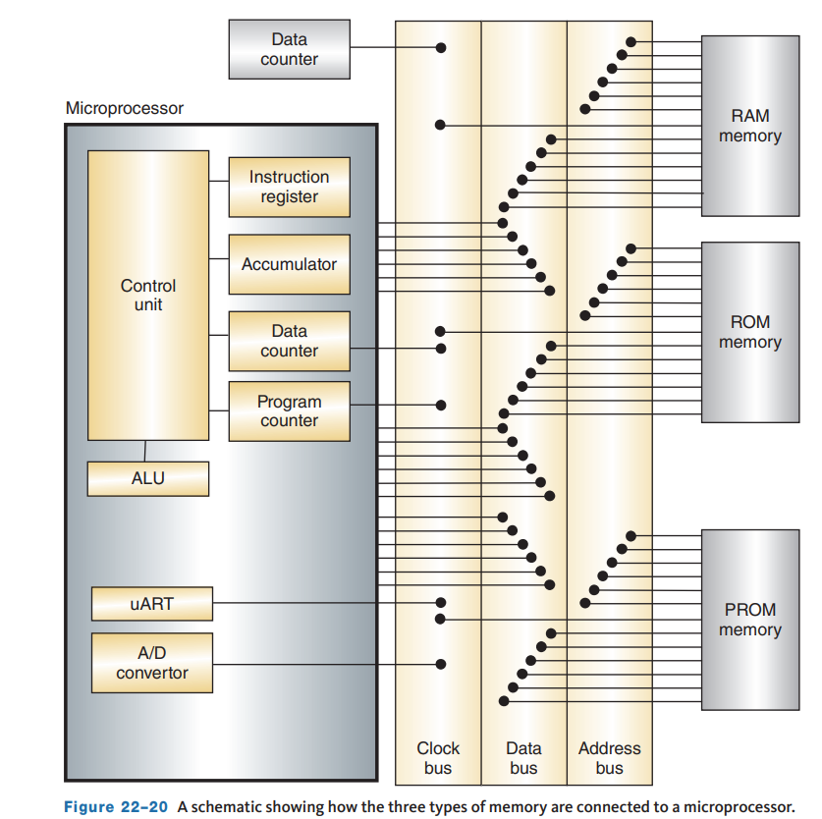
Memories
A computer’s memory holds the programs and other data, such as vehicle calibrations, which the CPU refers to while making calculations.
The program is a set of instructions or procedures that it must follow.
Included in the program are look-up tables that tell the computer when to retrieve an input (based on temperature, time, etc.), how to process it, and what to do with it after it has been processed.
Look-up tables are sets of instructions, and there is one for every possible condition the computer may detect.
Three types of memory are used in automotive CPUs today: read-only memory, programmable read-only memory, and random-access memory.

Slide 23
Awake/Sleep Modes
The control modules can control or perform all their functions in the awake mode.
They enter a sleep mode when normal control or monitoring of the system functions has stopped, and a time limit has passed.
There is still some activity during the sleep mode; what occurs depends on the system.
Basically, during the sleep mode, only enough power is used to maintain memory and for periodic monitoring of some systems.
Once normal computer activity is called for, the computer wakes up and resumes its normal functions.

Slide 24
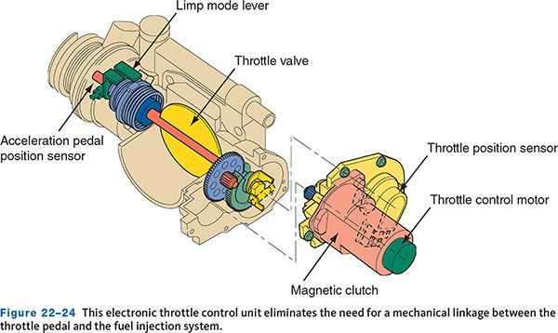
By-Wire Technology
One of the things that has become a reality because of the high-powered computers used in today’s vehicles is by-wire technology.
Currently, this technology has eliminated the mechanical connection from the throttle pedal and the fuel injection system.
This unit is called the electronic throttle control unit.
Shift-by-wire technology is also used.
It is also being used by manufacturers in brake systems and adaptive cruise control.
Nissan has a steer-by-wire system.

Slide 25
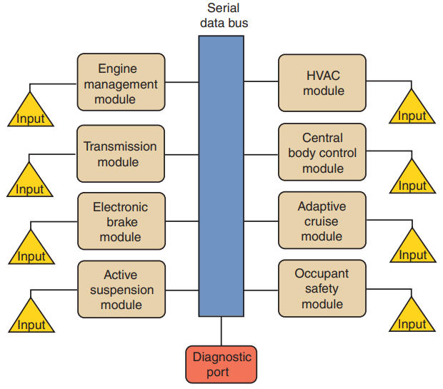
Multiplexing
22.05 Explain the principle of multiplexing.
Communication can take place through wires connecting each sensor and circuit to the appropriate control module.
If more than one control module is involved, additional pairs of wires must connect the sensor or circuit to the other modules.
The result of this communication network is miles of wires and hundreds of connectors.
To eliminate the need for all of these wires, manufacturers are using multiplexing.
Multiplexing provides efficient communications between vehicle systems.
Multiplexing relies on communication over one or two wires that allows many systems to communicate instead of using many wires.

Slide 26
Advantages
22.04 Explain the advantages of using electronic control systems.
Here are some of the advantages multiplexing offers over traditional wiring:
  The need for redundant sensors is eliminated because sensor data, such as vehicle speed and engine temperature, are available on the serial data bus where they can be used by several control modules.
  Accessories and vehicle features can be easily added to the vehicle through software changes.
  Fewer wires are required for the operation of each system, which means smaller wiring harnesses, lower cost and weight, and improved serviceability, reliability, and installation.
  Without multiplexing, it is necessary to add a ground, a power source, and control wires whenever an electronic component is added to the vehicle.

Slide 27
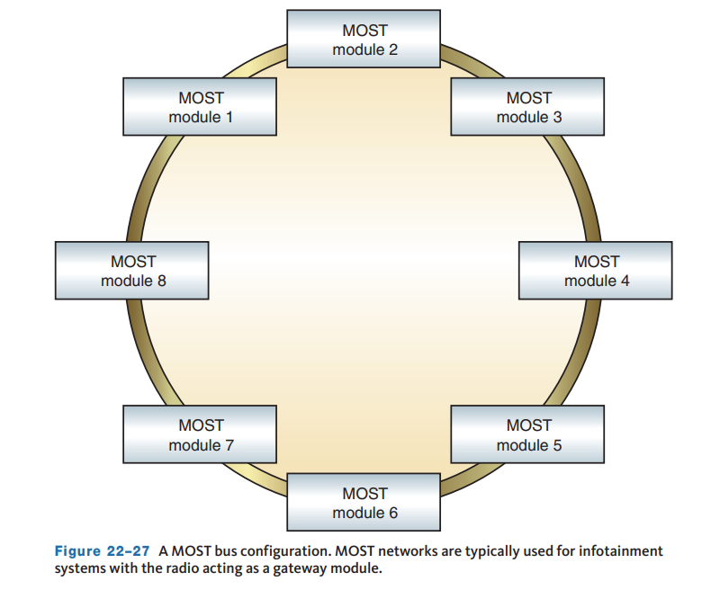
Communication Protocols (1 of 2)
22.06 Explain the principle of computer communications.
A protocol is the name for the language that computers speak when they are talking to each other.
The differences in protocol are based on the speed and the technique used. The SAE has classified the different protocols by their speed and operation.
Class A (low-speed communication):
  This is used for convenience systems, such as audio, trip computer, seat controls, windows, and lighting. Most Class A functions require inexpensive, low-speed communication and use a generic universal asynchronous receiver/transmitter (UART).

Slide 28
Communication Protocols (2 of 2)
Class B (medium-speed communication)
  Used primarily with the instrument cluster, vehicle speed, and emissions data recording. Contained within this classification are different standards, designated by a number. The most commonly used is the SAE J1850 standard.
Class C (high-speed communication):
  For communication with powertrain, vehicle dynamics, brake-by-wire, and other systems. This protocol can use a twisted pair, but shielded coaxial cable, Category 5 (Cat 5) network cable, or fiber optics may be used for less noise interference. The predominant class C protocol is CAN 2.0.
LIN Bus:
  The local interconnect network (LIN) is a single wire serial data network with a master and up to 16 slave modules. LIN is used primarily for low speed (under 20 kbits/s) non-safety-related systems such as power windows and locks, lighting, wipers, and seat controls. An individual switch or smart device may be used as a module on a LIN bus to communicate an input request, such as turning on a heated seat.

Slide 29
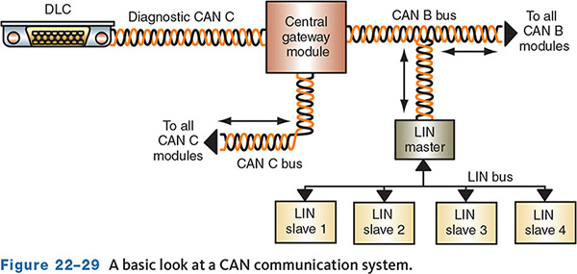
Can Buses (1 of 3)
The total network in most vehicles comprises three to six HS-CAN buses plus other lower-speed buses.
As manufacturers continue to add expansion buses, subdividing sections into small sub-networks, the number of networks increases.
Expansion buses are typically not accessible from the DLC.
Instead, they are accessed through a gateway or other module.
Each of these networks may operate at different speeds.

Slide 30
Can Buses (2 of 3)
The different CAN buses are identified by a prefix or suffix.
For example, a medium-speed bus may be called CAN B or MS-CAN. Likewise, a high-speed bus can be called CAN C or HS-CAN.
Manufacturers are not consistent with these labels, so there are a variety of them. Low- or medium-speed CANs are typically used for body functions, such as:
  Interior and exterior lights, Horn, Locks, Windshield wipers, Seats, Windows. Basic sound systems
  A high-speed bus is used for real-time functions such as: Engine management, Antilock brake systems, Transmission control, Tire pressure monitoring systems, Vehicle stability systems. Air bag and safety systems
These networks are integrated through the use of a gateway which allows for data exchange between the different buses.
It translates a message on one bus and transfers that message to another bus without changing the message.
The gateway interacts with each bus according to that bus’s protocol.

Slide 31
Can Buses (3 of 3)
Each network bus may carry a different voltage (Figure 22–30), such as a 5- or 7-volt communication signal with a 10- or 12-volt wake-up signal.
CAN bus communication uses two wires, Bus + (positive or dominate) and a Bus − (negative or recessive). Both wires carry 2.5 volts when idle or not communicating.
During communication, the positive wire signal switches from 2.5 to 3.5 volts and the negative wire drops from 2.5 to 1.5 volts.
The signals mirror each other to eliminate electrical noise and reduce communication errors.
The difference between the two signals is 2 volts.
Even the slightest change in voltage can affect the operation of one or more systems; therefore, all potential for voltage spikes, electrical noise, or induction must be eliminated.
Twisting the wires eliminates the possibility of voltage being induced in one wire as current flows through the other.
To eliminate other potential spikes and noise, two 120Ω resistors are connected in parallel across the ends of the main CAN bus wires called terminating resistors.

Slide 32
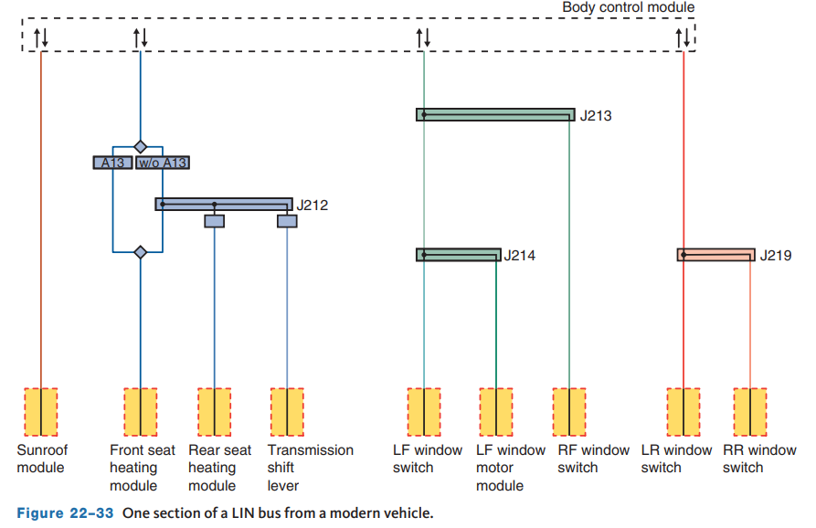
Lin Buses
Local interconnect networks (LINs) are single-wire networks with a master control module, often the BCM or equivalent, and one or more smart switches or sensors.
LINs typically operate using a network voltage of 12 volts. When the system is idle, a steady 12 volts will be present on the bus.
Modules and smart devices communicate by toggling the 12 volts between approximately 1 volt below the system voltage and 1 volt above the system ground.

Slide 33
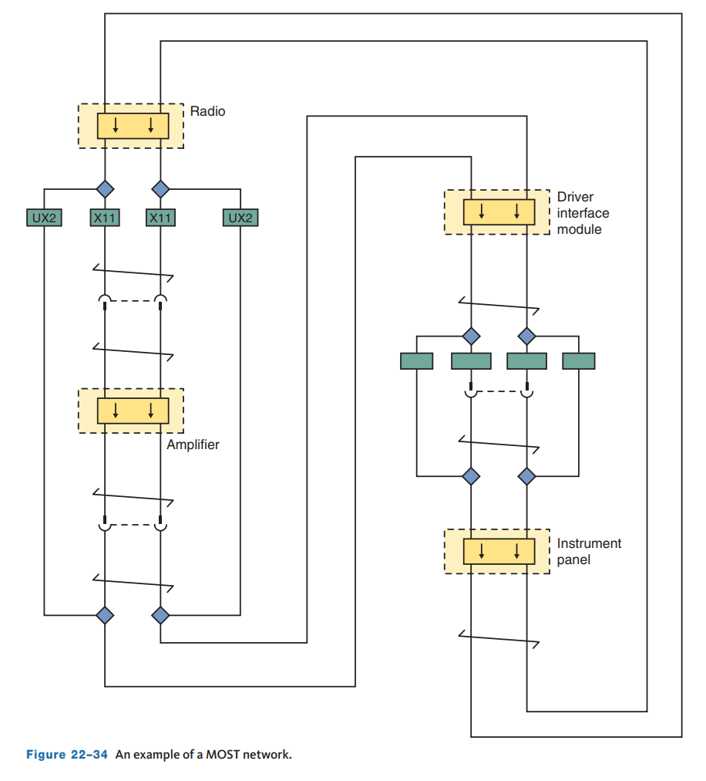
MOST Networks
MOST networks are dedicated high-speed
data-streaming buses for infotainment systems.
As with LIN buses, MOST networks are separate from the other HS-CAN networks.
The radio unit is typically the MOST master module, which acts as the network controller.
Devices on the network receive a low-voltage wakeup message and then report their addresses and functions to the MOST master.
The MOST master then orders the devices based on their responses, which will show on a scan tool as nodes, typically listed 1–9 depending on the number of modules on the network.
The configuration is stored as the Last Working MOST ID.

Slide 34
Protecting Electronic Systems
22.08 Describe the precautions that must be taken when diagnosing modules and networks.
You should be aware of the ways to protect electrical systems and electronic components during storage and repair. Keep the following in mind at all times:
  Vehicle computer-controlled systems should avoid giving and receiving jump-starts due to the possibility of damage caused by voltage spikes.
  Do not connect or disconnect electronic components with the key on, including scan tools. Never disconnect a scan tool while it is communicating with the vehicle.
  Never touch the electrical contacts on any electrical or electronic part. Skin oils can cause corrosion and poor contact.
  Before touching a computer, always touch a good ground first. This safely discharges any static electricity.
  Do not connect jumper wires across a sensor unless indicated in the service information to do so.
  Never apply 12 volts directly to an electronic component unless instructed to do so.
  Never use a test light to test any computer-controlled system unless instructed to.

Slide 35
Knowledge Check (1 of 2)
What should a technician always touch a good ground before touching a control module or computer?

Slide 36
Knowledge Check Answer (1 of 2)
Answer: Before touching a computer, always touch a good ground first. This safely discharges any static electricity. Static electricity can generate up to 25,000 volts and can easily damage a computer.

Slide 37
Network Security
Beginning in the 2010s, manufacturers began to protect their onboard networks using firewalls and secure gateways.
The need for these protocols arose from vulnerabilities discovered in the infotainment and wireless networks used on modern cars and trucks.
These vulnerabilities were discovered by remotely hacking into onboard systems, which allowed access to functions in the braking and steering systems without any physical connection to the vehicle.
Needless to say, this caused vehicle manufacturers to take steps to lock down the networks and prevent unauthorized access.
Secure gateway modules and similar arrangements that physically separate networks from the DLC provide isolation between networks and improve safety and security.
Using an aftermarket scan tool or J2534 passthrough device on some vehicles requires registering the tool and shop with AutoAuth.com to gain access to the OBD data stream.
Without using a registered device, passive access to the network is allowed, meaning reading codes and data. However, bidirectional functions such are blocked.

Slide 38
Trouble Codes
There are as many ways to perform diagnostics as there are automobile manufacturers.
Nearly all vehicles require a scan tool to retrieve DTCs.
The scan tool is plugged into the diagnostic connector for the system being tested.
The technician chooses the system to be tested through the scan tool.
Once the DTCs are retrieved, follow the appropriate diagnostic chart to isolate the fault.
It is important to check the codes in the order recommended by the manufacturer.
Remember, the trouble code does not necessarily indicate the faulty component; it only indicates the circuit of the system that is not operating properly.
To locate the problem, follow the diagnostic procedure in the service information for the code received.
Faults with the data communication systems typically result in the setting of Uxxxx codes.
The U prefix is reserved for network DTCs. Diagnosis should continue with a good visual inspection of the circuit involved with the code.
Check all sensors and actuators for physical damage. Check all connections to sensors, actuators, control modules, and ground points.

Slide 39
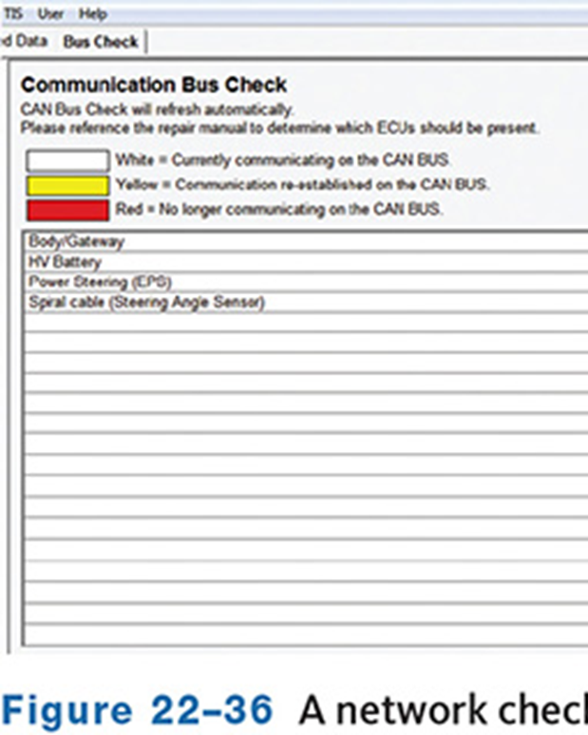
Communication Checks
Performing diagnostic checks on vehicles with a multiplex system should begin with a communications check.
Connect the scan tool and power it on and turn the vehicle’s ignition on to the RUN position.
Once the scan tool is installed, try to communicate with every module that could be in the vehicle.
If an option is not there, the scan tool will display “No Comm” for that control module.
That same message will appear if the module is present but not communicating.
The scan tool may have a network or module test function which allows you to “ping” or communicate with each system and its modules.
Some modules may not communicate because that particular vehicle is not equipped with that system.

Slide 40
Reprogramming Control Modules
22.09 Reprogram a control module in a vehicle.
Before going deeply into diagnosing an electronic control circuit, it is wise to check all TSBs that may relate to the problem.
Often, there will be one that recommends reprogramming of the computer. This is typically called “flashing” the computer.
When a computer is flashed, the old program is erased and a new one written in. Reprogramming is often necessary when the manufacturer discovers a common concern that can be solved through changing the system’s software.
New programs are downloaded into the scan tool and then downloaded into the computer through a dedicated circuit.
Each type of scan tool has a different procedure for flashing. Always follow the manufacturer’s instructions.
Some scan tools are connected to a PC, and the software is transferred from a CD or a website.
It is important to know that any interruption in the flash process can ruin a new module.

Slide 41
Testing Electronic Circuits and Components
Most electronic circuits can be checked in the same way as other electrical circuits. However, only high-impedance meters should be used.
A lab scope is a valuable tool for diagnosing electronic circuits. The scope is primarily used to measure voltages, pulse, and duty cycle.
The scope displays voltage over time, and the increments for voltage and time can be modified to provide a good look at the circuit’s activity.
Frequency is a term that describes how often a signal performs a complete cycle and is measured in hertz. To determine the frequency of something, divide the length of time it takes to complete one cycle into 1.
Whenever using a scope on a circuit, always follow the meter’s instruction manual for hookup and proper settings.
Most service manuals have illustrations of the patterns that are expected from the different electronic components.
If the patterns do not match those in the manual, a problem is indicated. The problem may be in the component or in the circuit.

Slide 42
Measuring Changing Voltages
A DMM may have AC selection modes for voltage and amperage.
These modes are used to measure voltages and amperages that change polarity or levels very quickly.
Most meters display the average voltage or current in an AC circuit.
Some meters display root-mean-square (RMS) readings, which are very close to being average readings.
  There may be slight differences as this scale compensates for extreme fluctuations in voltage and current flow.

Slide 43
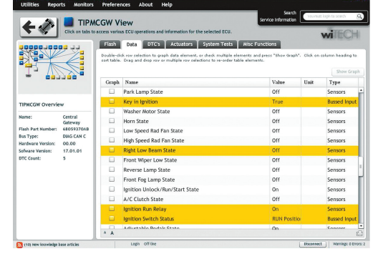
Testing Actuators
Each manufacturer may prescribe a specific procedure for checking an actuator .
The tests may rely on the use of scan tool or lab scope.
When checking an output, pay attention to the commands of the BCM and the response of the actuator.
A scan tool can not only control the actuator, but display the status.

Slide 44
Knowledge Check (2 of 2)
What tool is able to control the output of an actuator while also showing its status?

Slide 45
Knowledge Check Answer (2 of 2)
Answer: A scan tool

Slide 46
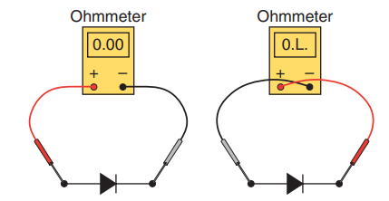
Checking Diodes
Multimeters can be used to check diodes, including Zener diodes and LEDs.
Regardless of the bias of the diode, it should allow current flow in one direction only.
Connect the meter’s leads across the diode. Observe the reading on the meter.
Then reverse the meter’s leads and again observe the reading.
  The resistance in one direction should be very high or infinite and close to zero in the other direction.
  If any other readings are observed, the diode is bad. A diode that has low resistance in both directions is shorted.

Slide 47
Chapter Reflection
Please take a moment to consider what you have learned about basics of electronics and computer systems. Then respond to the following questions in one or two paragraphs. Use 150–200 words in your reflection.
Did you feel you understood everything in this chapter? What do you feel you can do to better understand some of the more difficult concepts?
Considering all you have learned, do you feel prepared to perform the services and diagnosis of computer systems in the shop or lab setting? How can you better prepare?

